Slide 1


Group 4
By: a bunch of nerd high school students

Slide 2
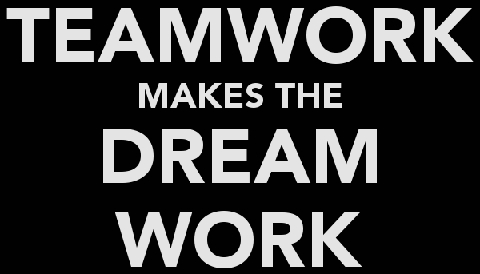
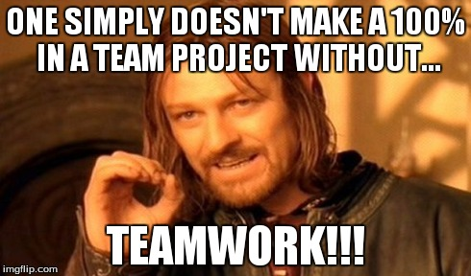
Roles/ Responsibilities
me- Programming/ Outline
guy2 -Programming/ Powerpoint
guy3- Powerpoint/programming
guy4- Powerpoint/programming
guy5- Flow Chart/Programming

Slide 3
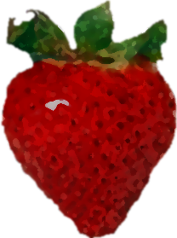

Theme: Across The Universe
Your theme – What was the theme? How did you use it in your project?
Our theme is “Across The Universe”.
We used this theme in our powerpoint.
“Across the Universe” is a movie based on music by the beatles, mostly by the songs “Across the Universe” and “Strawberry Fields Forever”.

Slide 4
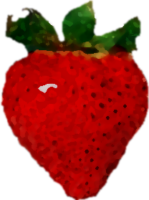

Approach to the Project
Your approach to the project – what are the things your group tackled/handled differently than other groups
We handled the distributing of the code differently by having everyone do same code at once leading to less errors and a stronger code.
Using the outline as a guide, we created the flow chart. We used the flowchart as a outline for the code of the game.
We completed the powerpoint with extra effort being put into the quality and aesthetic.
when we were done we completed the powerpoint with knowledge we had from the programming

Slide 5

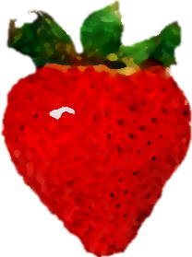
Challenges
Challenges in programming this assignment
By far the biggest challenge we had to overcome was developing the code for the scoresheet in Yahtzee. However, coding the entire program was challenging itself.
Truly working together and assigning work equally was another challenge we had to overcome.

Slide 6
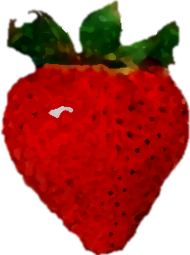
Wows
“Wows” – the extra things you added to your program
More than 2 player possible (total of 6)
Shows user what score will be returnded if they choose a certain category.

Slide 7

What we learned
What you learned as a group from this assignment.
As a group we learned how to work together and how to assign work properly
We learned how to program a game of yahtzee in Java.
We learned how to create a flow chart.
And we learned that we need WOWs to stay ahead of the competition

